Slide 1
DevOps & Databases
Challenges & Possibilities
Stuart R Ainsworth
@codegumbo
http://codegumbo.com

Slide 2
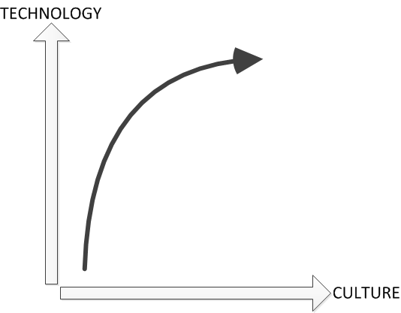
YOU
ME
YOU
Database Experience
Analytic Focus
Learning-centered
Desire to build modern skills
Mgr, SRE GT, aPS, aJHc
Former Data Architect, DBA, developer
AtlantaMDF Chapter Leader
Infrequent blogger: http://codegumbo.com
My career trajectory

Slide 3
Background

Slide 4
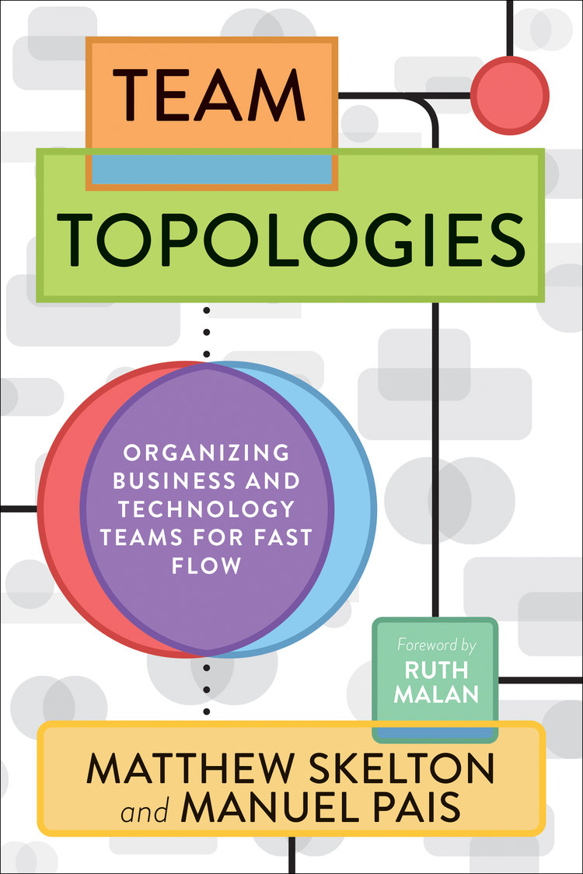
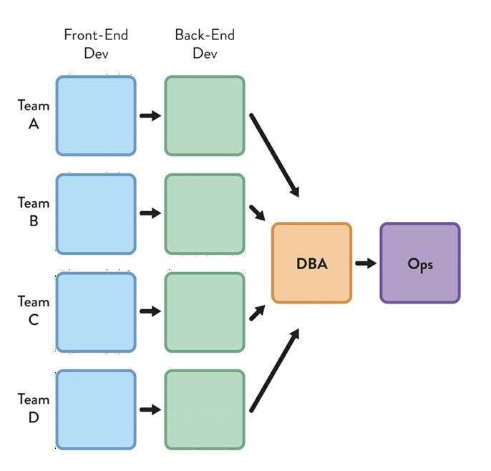
FLOW: TYPICAL DATABASE WORK

Slide 5
DevDataOps*
Development: historically creative, future-thinking
Database: historically protective, past-thinking
Operations: historically supportive, present-thinking
THESE MENTALITIES DO NOT SCALE WELL UNDER SILOS.
*not coining a new term; DevOps is all-inclusive and fine.

Slide 6
How did we get here?
Database systems have both a creative and a maintenance phase; why are skills typically siloed?
RDBMS was developed in early 70’s; compensation for growth in scale of database versus cost of hardware. Normalization and strong typing allowed for cost cutting, while adding performance capability.
“And you may ask yourself, well How did I get here?” – Talking Heads

Slide 7
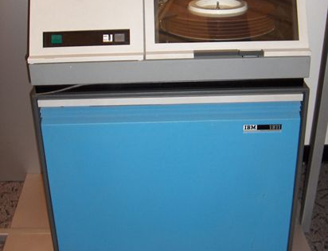
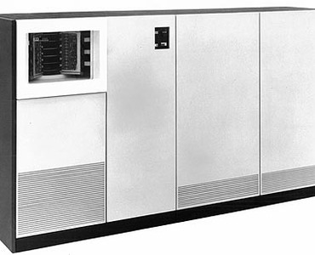
Storage in early 1970’s
IBM 1311 Removable Disk Packs prevalent in early 1970’s
Each pack was 2MB of storage
Approximately $2M 1967 -> $15.5M (2020)
IBM 2305 fixed head drives
5 MB; not removable
$253K (1971) -> $1.6M (2020)

Slide 8
How did we get here?
The same people responsible for safeguarding the data also had to understand the schema used to represent that data.
“Any sufficiently advanced technology is indistinguishable from magic.” – Arthur C. Clarke
“And you may ask yourself, well How did I get here?” – Talking Heads

Slide 9
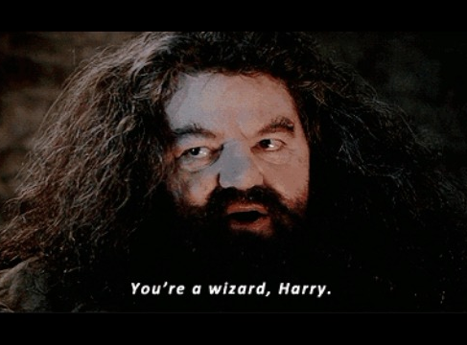

Slide 10
Developers
Database Administrators
Operations
Multiple Languages
Understand Business Goals
Single Language
Feet in both worlds
Understand costs
Focus on Reliability
Focus on performance
Focus on Value

Slide 11
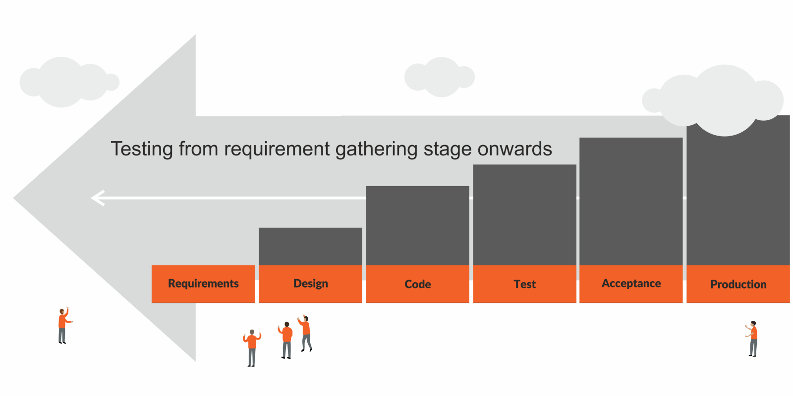
DevOps: Shifted Thinking
Agile – speed of delivery
Lean – elimination of waste
Exponential computational power
Shift Left
Put more resources into design
Reduce cost of operation

Slide 12
Background

Slide 13
DevOPs: A (Very) Brief Overview
DevOps is focused on delivering quality, faster.
Philosophical approach, not methodological
Automation, infrastructure as code, continuous deployment
Emphasis on communication; silo reduction
Journey, not destination
Born out of Agile, several innovators contributing
Patrick Debois & Andrew Clay Shafer – Agile Infrastructure (Agile 08)
John Allspaw & Paul Hammond – 10+ Deploys Per Day (Velocity 09)
Gene Kim, Kevin Behr, & George Spafford – The Phoenix Project

Slide 14
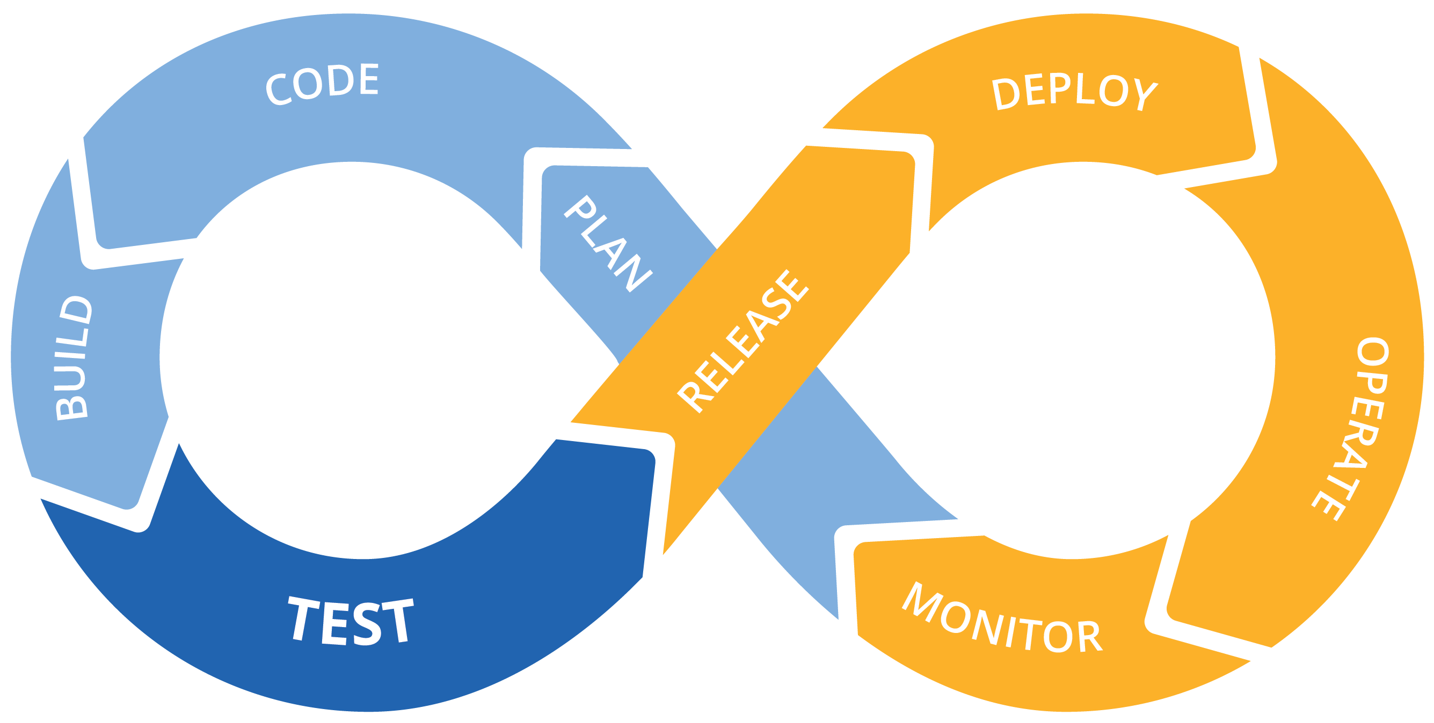

Slide 15
Two Commitments
Strive to take perspective.
Strive to continuously improve.

Slide 16
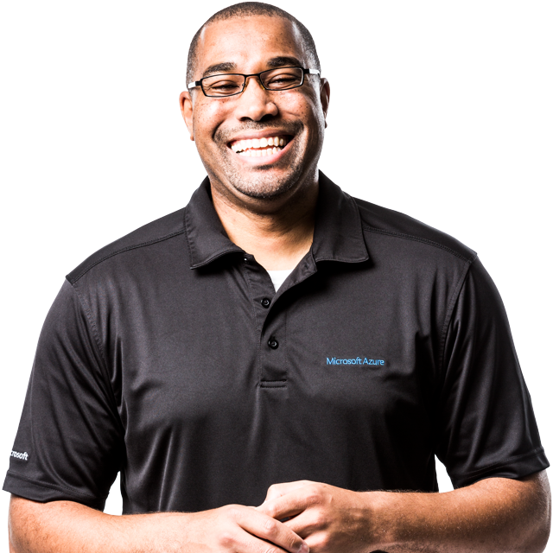
VALUE STREAM
A value stream is the series of activities (the how) creating a flow of value (realizing the value [product/service] that the customer gets).
“DevOps is the union of people, process, and products to enable continuous delivery of value to our end users.” – Donovan Brown

Slide 17
VALUE STREAM COMPONENT EXAMPLES
People
Coders
Operators
Management
Sales People
Customer Support Representatives
Process
Governance & Compliance
Release
Disaster Recovery
Products
Applications
Databases
Servers
Networking\Infrastructure

Slide 18
C
A
L
M
S
CULTURE
AUTOMATION
LEAN
MEASUREMENT
SHARING
https://itrevolution.com/devops-culture-part-1/
Notes:
CALMS originalay CAMS by Edwards and Willis, then Jez Humble suggested the L to make it a waord (because we love that). Frameworks are great; very descriptive without being prescriptive; we can look at each of these domains organizationally and say if I make a change, what does it impact?
Since it’s a word, though, people assume the flow is from left to right, and it’s much less structured than that. Each of the domains is relatively orthogonal; you can make changes in any one or all of them without mastering the others. However, I think there are some components that are more foundational than others.

Slide 19
STRATEGIC
TACTICAL
LEAN
MEASUREMENT
CULTURE
SHARING
AUTOMATION
Notes:
Lean thinking is foundational (and I’ll talk about each of these in more detail in a minute). You have to commit to certain basic concepts before your DevOps journey can begin, and then you have to agree on measurement
Remember that DevOps covers the whole value stream so you have to get folks to the table.
After thatm you may skew either more strategic or tactical, and that will affect your areas of influence.

Slide 20
CHALLENGES FOR DATABASE PEOPLE
Data retention
DevOps: Servers are cattle, not pets
Data must be preserved (backups, restores, DR\DA)
Data for testing
Data masking
Scalar variation between environments
DEV
AGILE
DESIGN
OPS
ITIL
BUILD
RELEASE
OPERATE
OPTIMIZE
DEPLOY

Slide 21
Foundations

Slide 22
Incrementalism
DevOps – small changes add up to big changes
Release small, release often
Smallest change you can make and subsequent dependencies
Views can provide transformational bridges
Versioning strategy
Table (historical) vs Point-In-Time
Application catalog

Slide 23
SOURCE CONTROL YOUR STUFF!!

Slide 24
Source Control – What?
Schema
DDL
Indexes
Named statistics
Lookup values
Roles

Slide 25
Source Control strategies
State-based
Migration
Generate scripts by comparing schema to the model
Pro: simplest to implement
Con: difficult to store metadata
Create migration scripts to move from one version to next
Pro: complex models
Con: conceptually harder

Slide 26
Automation: CI\CD

Slide 27
Why Automate?
Increase in quality
Smaller changes get caught sooner
Iterative testing allows improvements
Improved reliability
Faster Deployments = time saving

Slide 28
Challenges

Slide 29
Issues of State
Databases marry schema and data (unlike apps)
Dropping or renaming items can lose data
Data modeling is often overlooked
Data meaning
Data importance

Slide 30
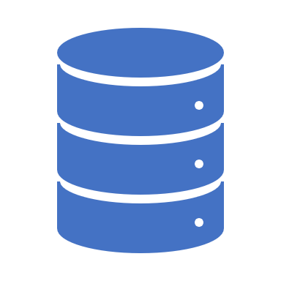
Potential Solutions
Decide on approach
State Based (Visual Studio Database Projects)
Migration Based (RedGate SQL Change Automation, Flyway)
Deploy small changes often
Better documentation
Maintain version catalog (App x V1 works with DB y V2)
Database diagramming tools

Slide 31
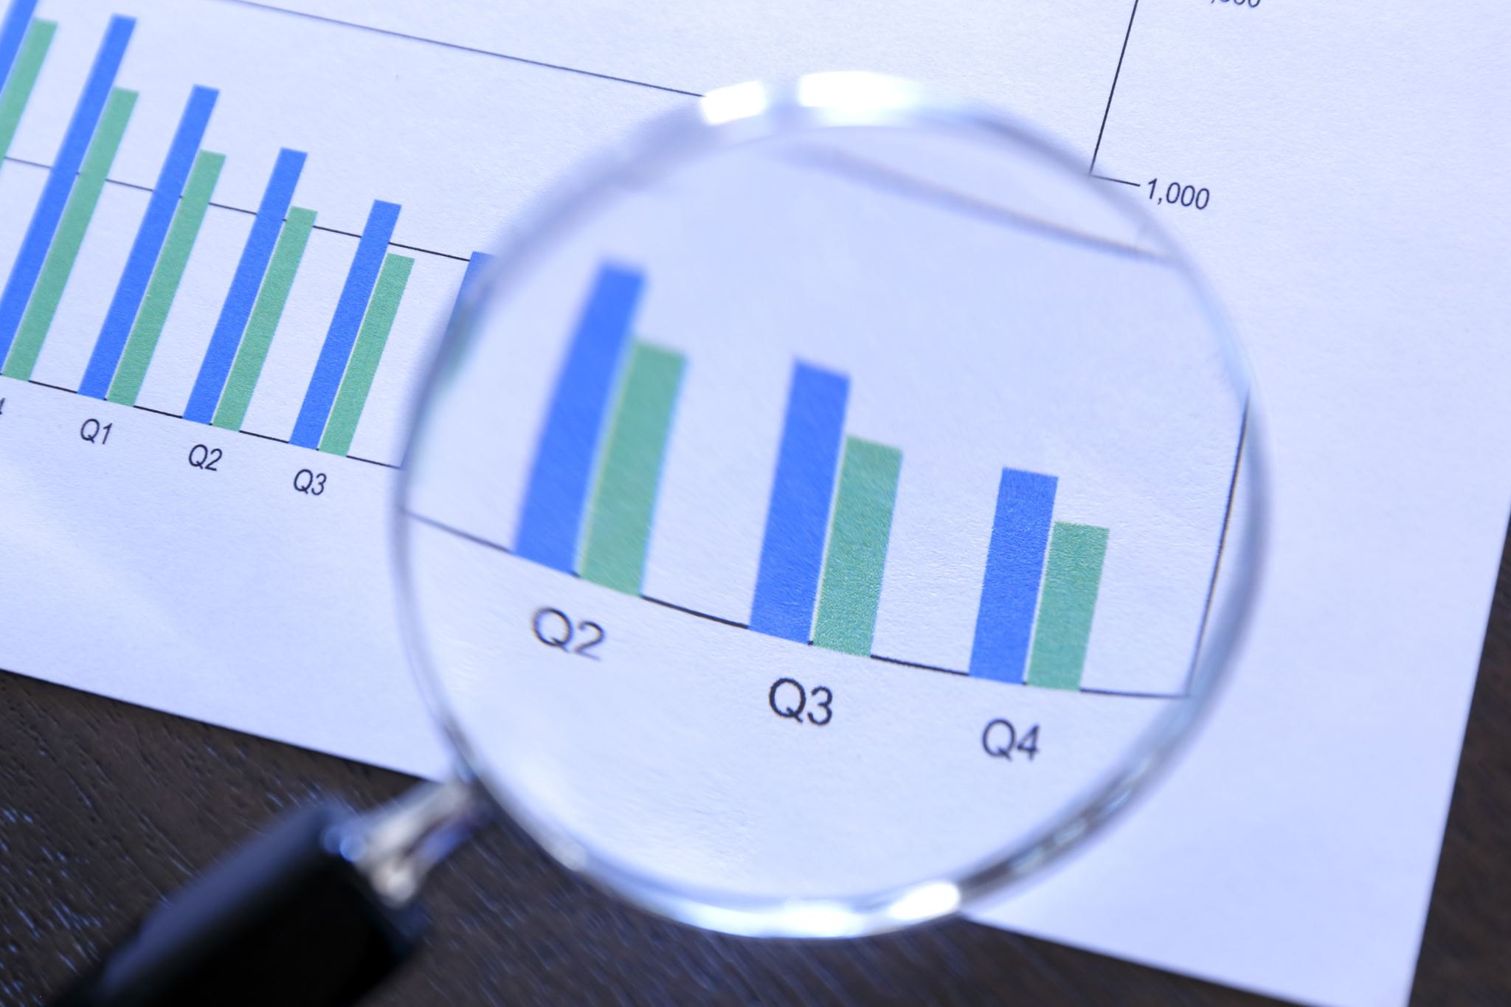
Issues of Scale
Restores
Differences in Specs
Usually related to perceptions
Why is your database large?
Acceptable Denormalization (Data Warehouse\logging)
Unfinished Architecture

Slide 32
Potential Solutions
Emulation or Compression
Virtualization (RedGate, Delphix)
Compression (Idera)
Architecture
Split denormalized sections from normalized sections
Filegroup Backup & Restore

Slide 33
Issues of Complexity
Linked Servers
Cross-database joins
Different kinds of data

Slide 34
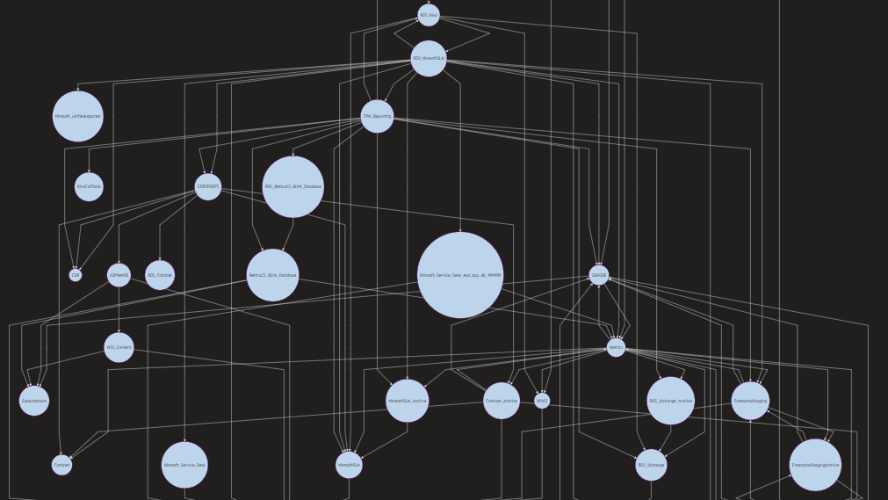

Slide 35
Service Oriented Architecture
Service (Application)
Database
Logical business activity with specific outcome
Self- contained
Black box for consumers
May consist of other underlying services
Use the right datastore for data; if relational, limit applications to logical breaks
Use ETL processes to synchronize across services

Slide 36
Closing Thoughts

Slide 37
Criticisms of DevOps
Too much Dev, not enough Ops
Focus on shifting left ignores operational mainstays
Maintenance
Infrastructure
Shift\Look Right
Developers need to participate
Operations need to automate scaling

Slide 38
Criticisms of DevOps
Painful to bring all voices to table
Culture is tough to change
Middle management often engage in turf wars
Need both bottom-up and top-down drivers

Slide 39
Criticisms of DevOps
Change Control\Auditing\Compliance
Classic “ITIL” implementations
Separation of duties
Change Control
Process can be automated too!
DevSecOps*
*real thing.

Slide 40
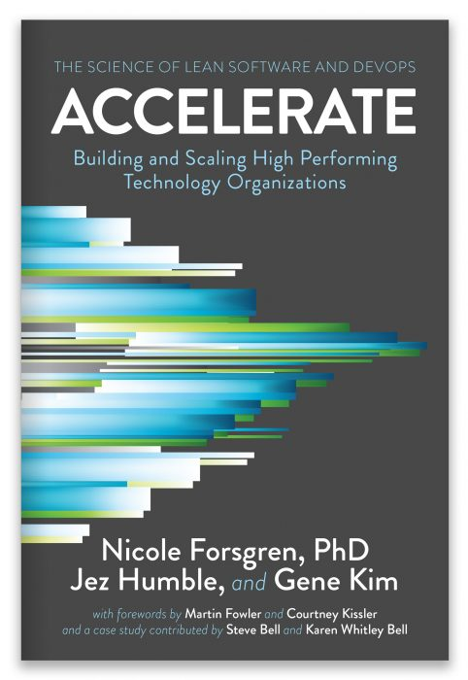
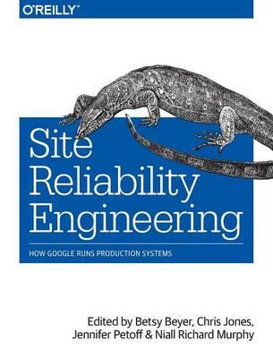
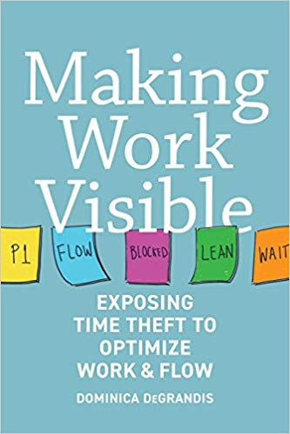
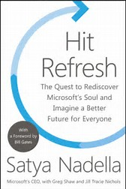
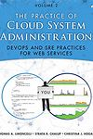
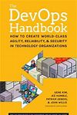
CONTACT
stuart@codegumbo.com
@codegumbo
http://codegumbo.com

