Slide 1
Managing A Technical Team: Lessons Learned
Stuart R Ainsworth

Slide 2
Presentation Rating:
BEGINNER
Little to no experience in this subject area

Slide 3
Presentation Rating:

Slide 4
Purpose
Cover some of the life lessons I’ve learned in my first couple of years of management
Discuss general concepts of management theory
Apply theory to technical management

Slide 5
Why Me?
Manager of team of DBA’s for financial services company
Former Data Architect, DBA, developer
Designed system that analyzes nearly 1 billion rows of data per day
AtlantaMDF Chapter Leader
Linchpin People TeamMate

Slide 6
Assumptions About You
Either considering management or a new manager
Technical background (developer, DBA, IT Admin)

Slide 7
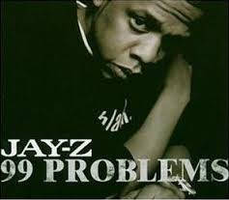
These ain’t the problems you’re used to solving…

Slide 8
How did you get here?
Companies choose managers
Best Operator
Obvious Choice
Invisible Person
Yardstick
Most IT Mgrs start “in the trenches”
Seniority
Formal Team Lead

Slide 9
Title <> Job Responsibility
Company Expectations:
Best Operator
Continue Technical Successes
Teach Skills
Personal Expectations:
Team will adopt your processes
Expand your influence
Expand capabilities

Slide 10
Management Definition
The Accomplishment Of Pre-Determined Objectives Through Others
Delegation – manage people, not production
Change – accomplish objectives

Slide 11
Title <> Job Responsibility
“TEAM LEAD”
“MANAGEMENT”
Company Expectations:
Best Operator
Continue Tech Successes
Teach Skills
Personal Expectations:
Team will adopt your processes
Expand your influence
Expand capabilities
Company Expectations:
Maintain Tech Results
Motivate Team
Efficiency
Effectiveness
Personal Expectations
Results, not methods
Relationships
Responsibility

Slide 12
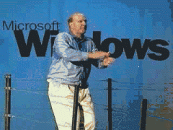
Act Like a Good Developer

Slide 13
What makes a good developer?
Desire to learn
Work is an extension of a hobby
SQLSaturday’s, Summit, books, blogs
Desire to collaborate
Learning from peers (debates)
Building networks around technology
Desire for efficiency
Reusable methods
Frameworks

Slide 14
Same traits, different focus
Desire to Learn
Try to read 1 management book a month
Podcasts
Manager Tools
Wily Manager
Desire to collaborate
PD courses at technical conferences
“buddy system” at user groups

Slide 15
Same traits, different focus
Desire for efficiency
Frameworks
MARS
LeanIT\Kanban
ITIL

Slide 16
MARS
Classification for department responsibility
DBA-centric
Four areas of work
Maintenance
Architecture
Research
Support

Slide 17
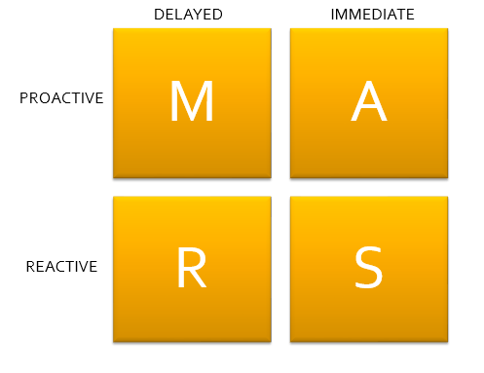
MARS
DELAYED
IMMEDIATE
PROACTIVE
REACTIVE

Slide 18
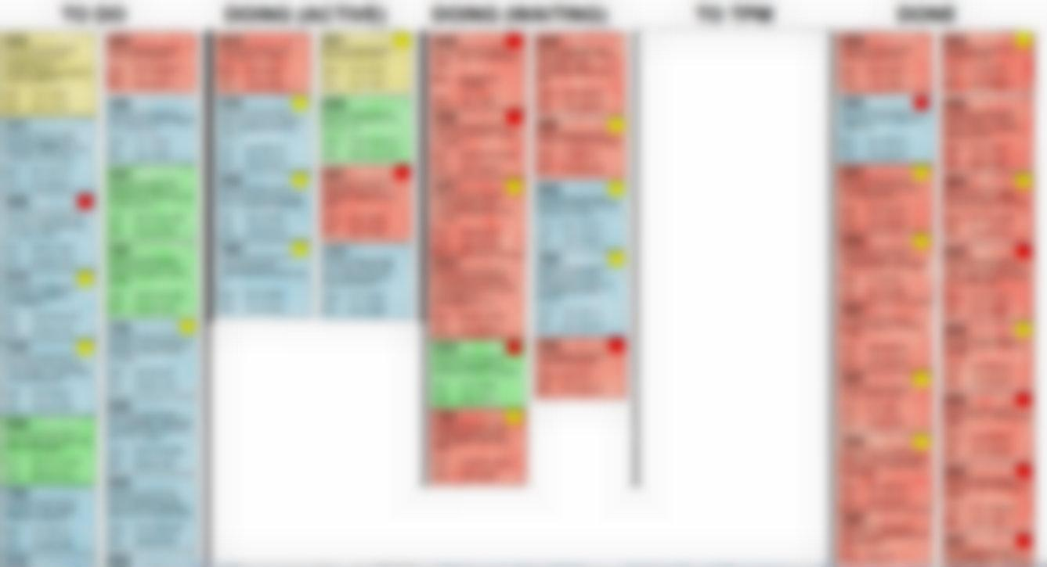
Kanban
TO DO
DOING (ACTIVE)
DOING (WAIT)
TO OTHER
DONE

Slide 19
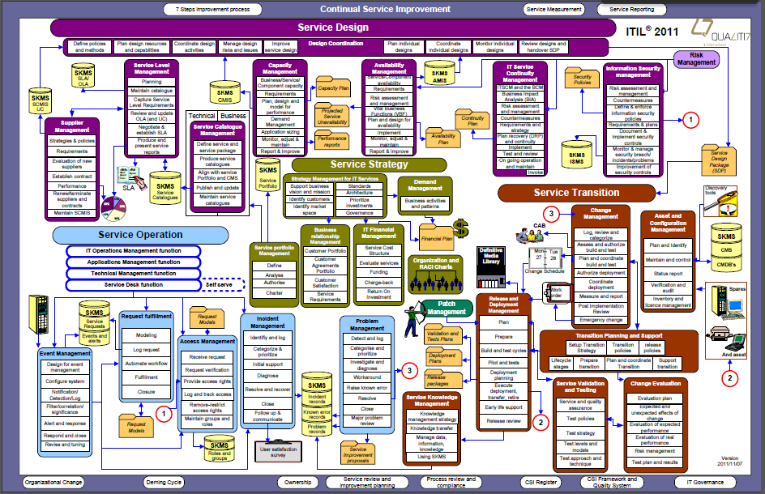
ITIL
Info Tech Infrastructure Library
Defines Service Responsibility
What gets Delivered by Whom

Slide 20
Same traits, different focus
Desire for efficiency
Frameworks
MARS – core areas of responsibility
LeanIT\Kanban – day-to-day focus
ITIL – interactions with others
Ultimate goal is change

Slide 21
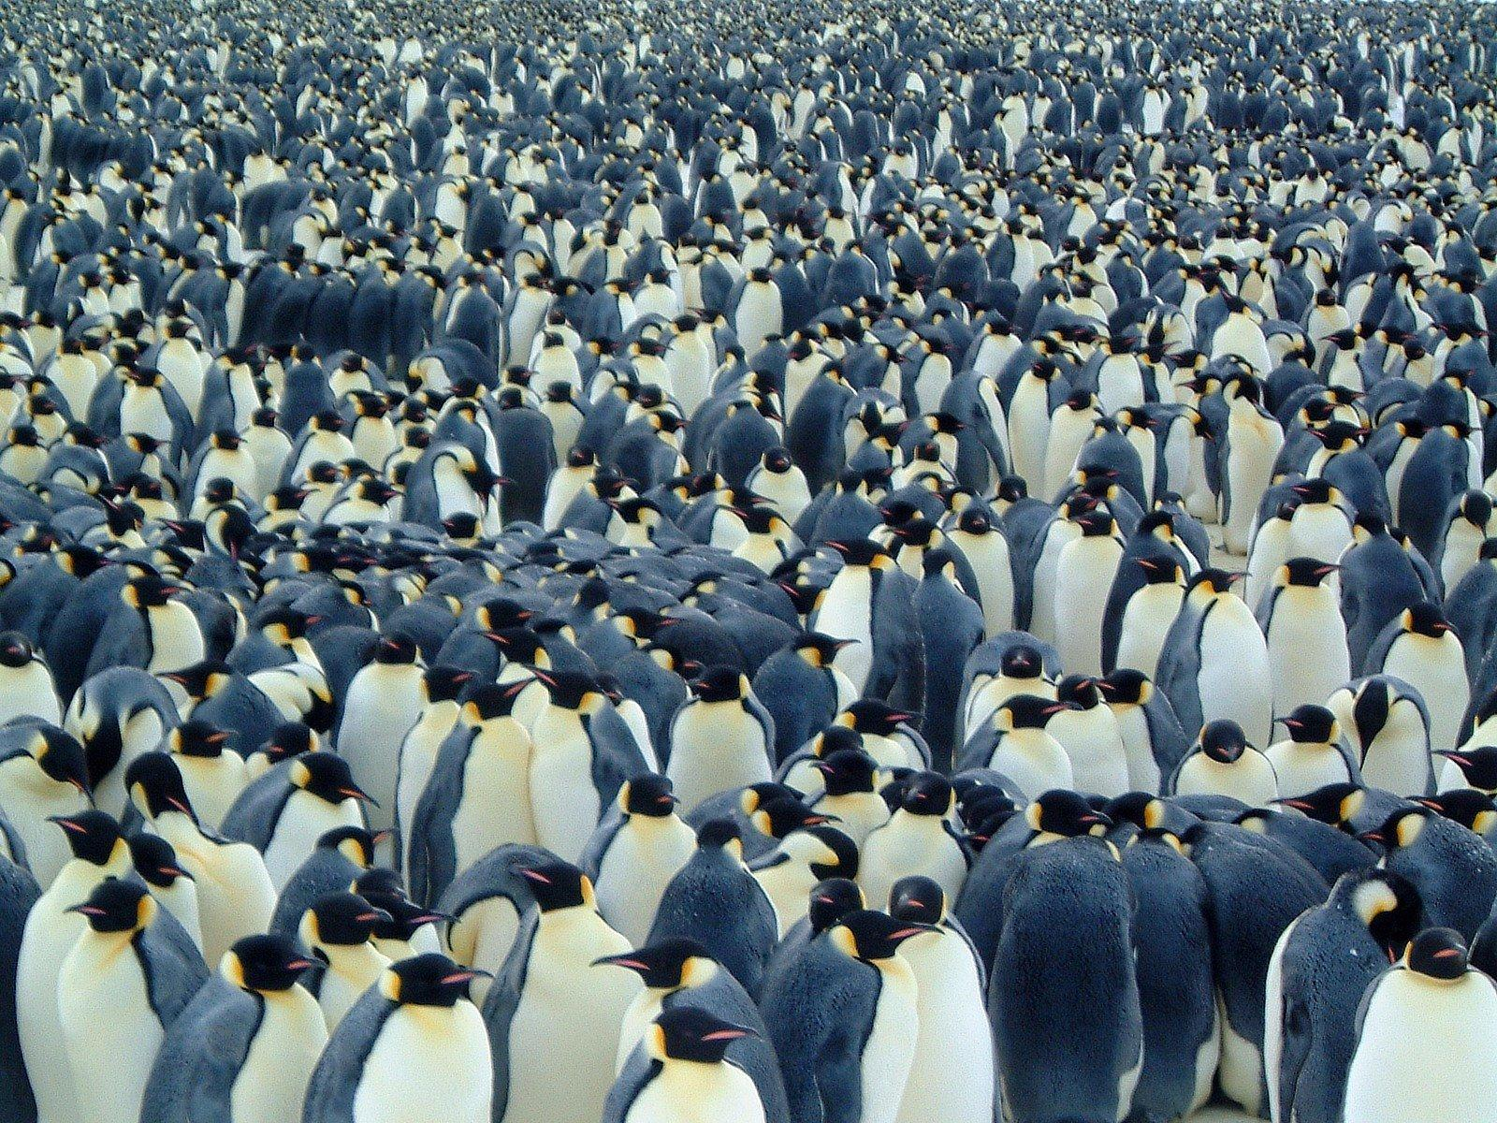
Your directs aren’t you…

Slide 22
Develop people, not just process
Process development improves efficiency
Repeatability
Reportability
People development improves effectiveness
Skill enhancement
Ingenuity

Slide 23
Strategies
Invest in Education
Answer with a Question
Encourage Actions, Even Failures
GOAL IS TO BUILD ENGINEERS BETTER THAN YOU EVER WERE

Slide 24
You’re not the model you think you are
Technical people take pride in work
“Best Operator”
Effective processes
Gets Results
Confident
Build an environment that fosters new “Best Operators”

Slide 25
RESULTS, not METHODS
Tough for most people to isolate
Outcome
Processes
Temptation for new manager
Force methods on team
Micro-management

Slide 26
Suggestions
Define Vision, Principles, & Goals
Let team define standards & methods
Assume Accountability
Measure team’s performance
Are they sticking to the standard they defined?
Are they using the methods agreed to?
Define a process for change
Goals change, standards change.
How do you update and address?

Slide 27
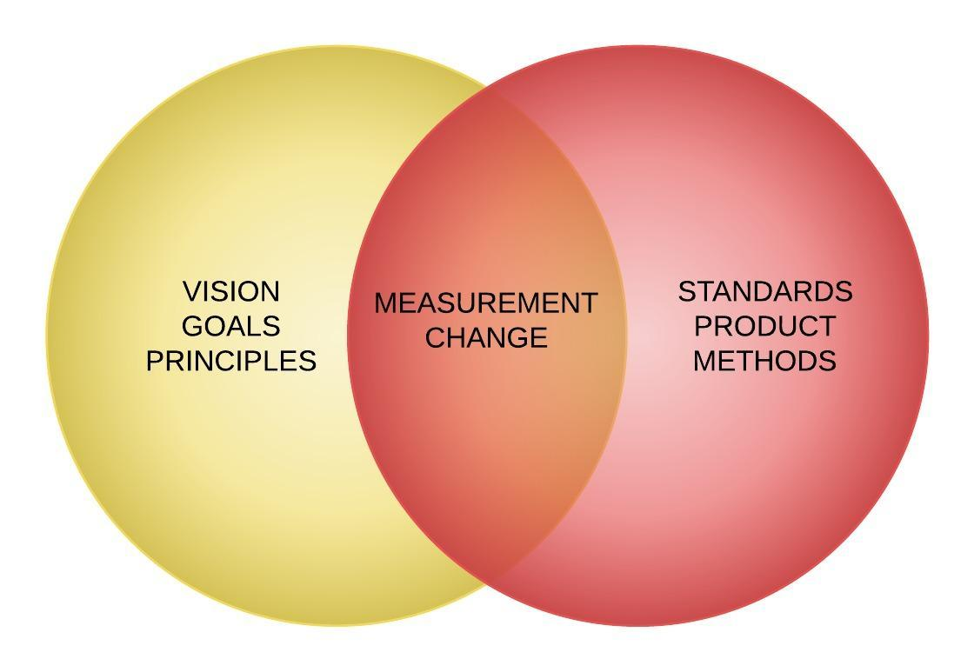

Slide 28
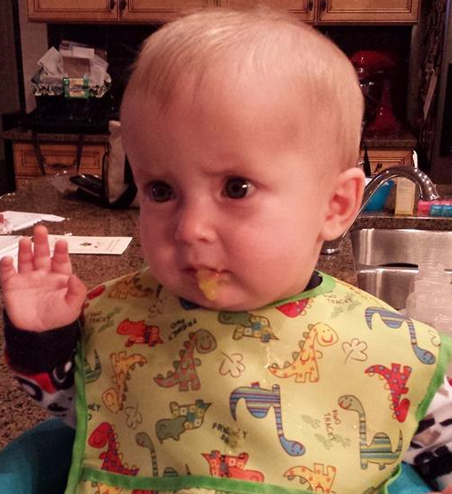
Change is hard; get over it

Slide 29
Change is needed for growth
The Accomplishment Of Pre-Determined Objectives Through Others
Process is change by definition
Once objective is met, new objectives
Maintenance, new goals
Temptation is to change it all at once

Slide 30
Change Curve

Slide 31
People resist change
Need time to adjust
Change takes time
Adjust to new normal
Changes should be measured
Changes should be incremental
Build, don’t replace
Evolve, don’t extinguish

Slide 32
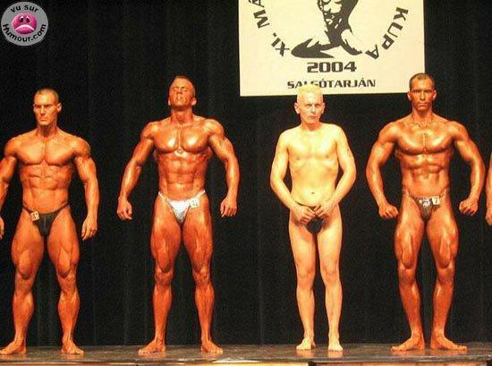
You have to start somewhere

Slide 33
Measurement
Results of change need to be measured
If you don’t have a metric, collect data
First 6 months of a new position
Eliminate immediate fires
Implement collection system
Wait
Consistency > accuracy

Slide 34
Measurement
Define core dept service offerings
Identify who’s responsible
Determine critical nature
Determine performance
Share measurement with employees
Metrics need to be perceived as realistic
What you measure is what gets done

Slide 35
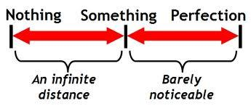
Perfection: Enemy of Good

Slide 36
Perfection Syndrome
Seeking perfection stifles action
Plan too much, never commit
Action yields results
Pareto principle
20% of full time to complete 80% of a task
Decide when “done” is

Slide 37
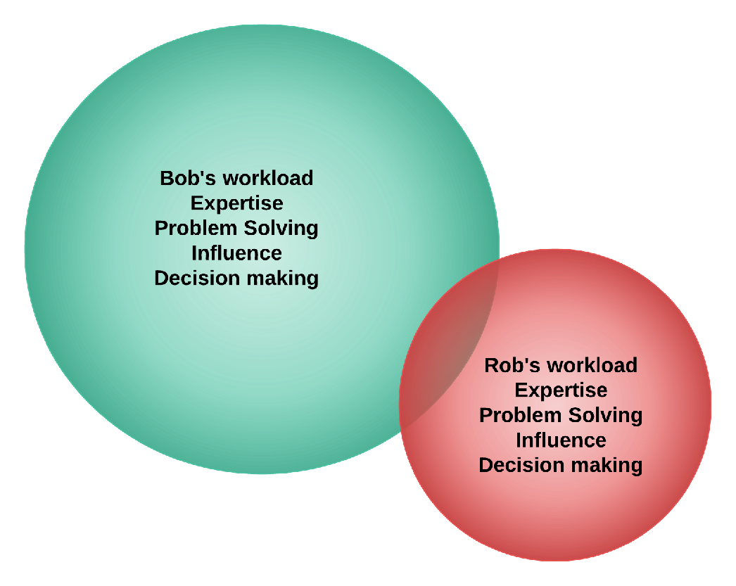
Example: Redundancy

Slide 38
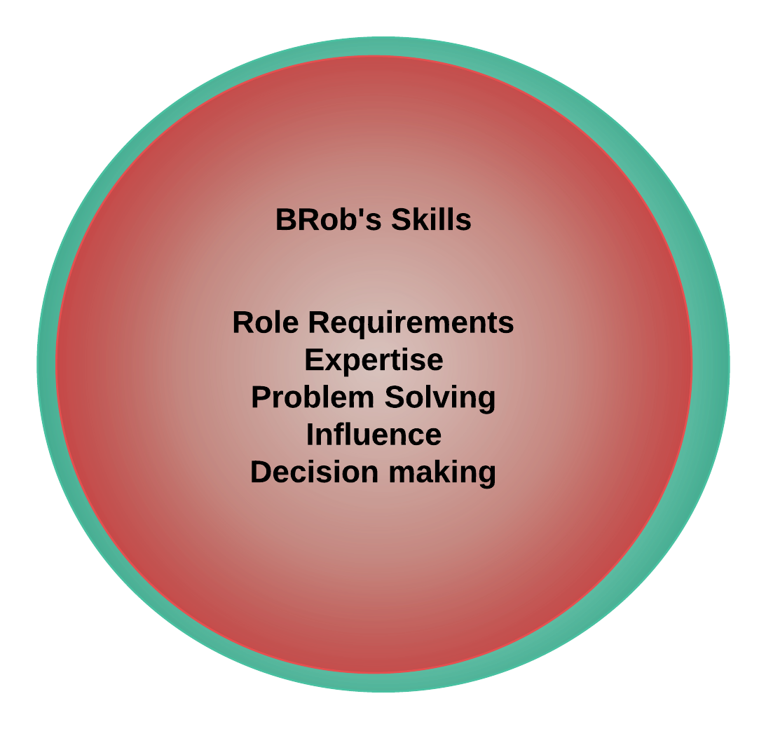
Desired Redundancy

Slide 39
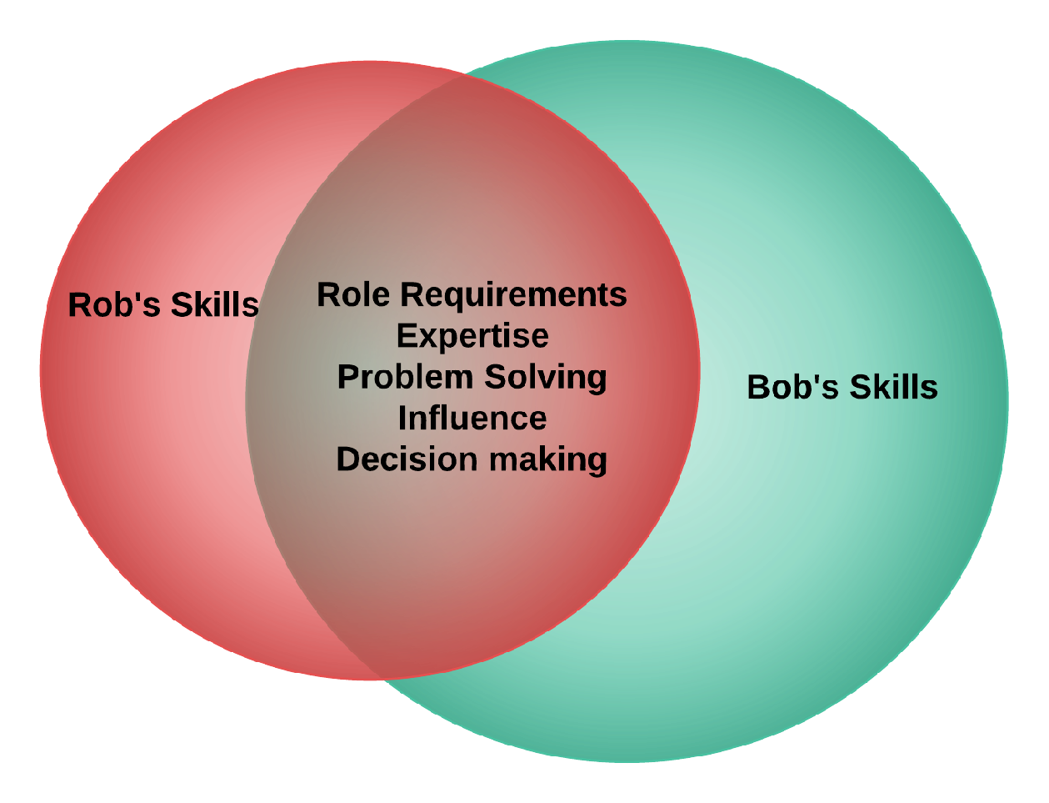
Actual Redundancy

Slide 40
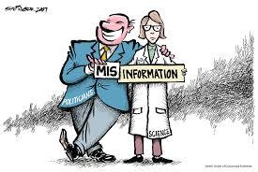
Find Time to Stay Technical

Slide 41
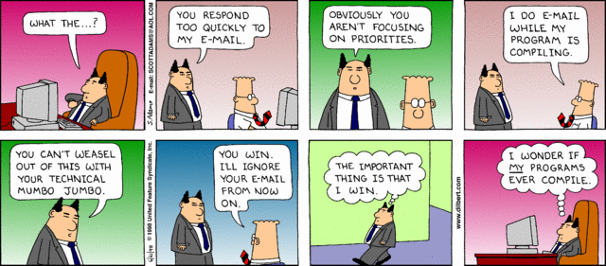
The Bad Manager
Doesn’t understand what team is doing
Doesn’t provide the necessary resources
Has unrealistic demands or expectations
“You can’t weasel out of this with your technical mumbo jumbo.” - PHB

Slide 42
The Technical Manager
Should understand concepts
Be up-to-date on latest technology
Understand what resources are needed by team

Slide 43
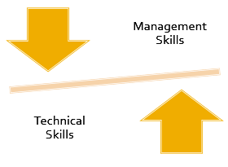
Don’t over do it…
Understand the issues
Don’t be “a team player”
Avoid being “the professor”
Choose what to retain

Slide 44
Processes decay

Slide 45
Entropy
“lack of order or predictability; gradual decline into disorder”
Left unchecked, processes decay
Shortcuts
Defined as “waste of time”

Slide 46
What gets measured
Gets managed…
Focus on key metrics
Be consistent
Refresh staff on them occasionally
Keep it simple
Change processes when it makes sense

Slide 47
Questions?
“It’s a miracle that curiosity survives formal education.” – Einstein

Slide 48
Contact Information
Stuart R Ainsworth
stuart@codegumbo.com
http://www.codegumbo.com
http://www.twitter.com/codegumbo

