Slide 1
Agile Database Administration
Stuart R. Ainsworth

Slide 2
About Me
Manager of newly-formed Database Administration group for a financial security company.
Former Data Architect; 6 years working primarily in a development department
Prior experience as DBA and a reporting/database developer
AtlantaMDF Chapter Leader

Slide 3
Why this topic?
Experience as a database developer
Scrum in the workplace
Scrum BOF meetings at TechED
Review of literature
Promotion to Manager
Stack of work
Needed to find a way to manage the workload

Slide 4
Purpose of Presentation
Cover Agile development principles
Extend Agile philosophy to DBA work
Suggest methods of managing DBA work.

Slide 5
About You

Slide 6
Introduction to Agile
Agile Principles

Slide 7
Agile Development - History
In February 2001, 17 software developers met at the Snowbird, Utah resort, to discuss lightweight development methods. They published the Manifesto for Agile Software Development to define the approach now known as agile software development.

Slide 8
Agile Manifesto
We are uncovering better ways of developing software by doing it and helping others do it. Through this work we have come to value:
Individuals and interactions over processes and tools Working software over comprehensive documentation Customer collaboration over contract negotiation Responding to change over following a plan
That is, while there is value in the items on the right, we value the items on the left more.
http://www.agilemanifesto.org/principles.html

Slide 9
Agile Manifesto
Business people and developers must work together daily throughout the project.
Welcome changing requirements, even late in development. Agile processes harness change for the customer's competitive advantage.
The best architectures, requirements, and designs emerge from self-organizing teams.

Slide 10
Algebra is like life…
Do what you HAVE to do, then do what you WANT to do.
Get these out of order, and you’ll probably wind up in jail
Agile methods are like algebra…
Work according to the principles first.
Choose the method by which you want to work.

Slide 11
Philosophy & Methods
Agile Principles
Scrum
XP
Agile Unified Process
Feature Driven Dev

Slide 12
Scrum
Agile Methods

Slide 13
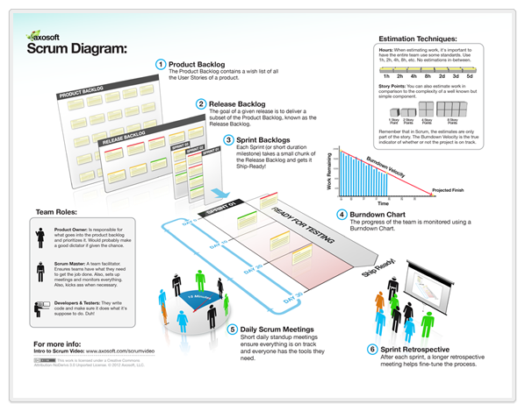
Scrum

Slide 14
Scrum: Elements
Product Backlog
Release Backlog
Scrum Backlog
Burndown chart
Daily Standup (Scrum)
Sprint Retrospective
http://www.youtube.com/watch?feature=player_embedded&v=XU0llRltyFM
http://axosoft.com

Slide 15
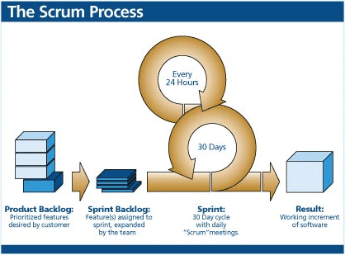
Scrum

Slide 16
Pop Quiz
What’s the most popular form of agile development in use today?
ScrumBut

Slide 17
Extending Agile Philosophy
Database Administration

Slide 18
Before we go on…
We’re still talking about development at this point; what happened to Database Administration?
We’re going to be agile in our approach to agile.
Borrow what we can, discard the rest.
Focus on communication, shared ownership
What are the key differences between them?
Development is product-focused
Administration is service-focused

Slide 19
Agile Buffet
Presentation at Tech-ED 2011
http://www.slideshare.net/sfnyc/the-agile-buffet-table
Joel Semeniuk and Steve Forte
OK to mix-and-match, but adhere to principles

Slide 20
Scrum and IT Mgmt
Scrum is cyclical
Tasks over period of time
Most work estimated before sprint starts
Always some percentage of new work
Estimates may not be valid
IT Mgmt (including DBA) is more reactive
Tasks come as needed
Difficult to estimate small projects

Slide 21
Scrum and IT Mgmt

Slide 22
Borrowing from Agile
AGILE PRINCIPLES
IT MANAGEMENT PROCESS
Business people and developers must work together daily throughout the project.
Welcome changing requirements, even late in development. Agile processes harness change for the customer's competitive advantage.
The best architectures, requirements, and designs emerge from self-organizing teams.
Team interaction
Business interaction
Simple, flexible processes
Measure “cost-of-change”
Team must “buy in” to process
Team members should play to their strengths.

Slide 23
Borrowing From Scrum
Daily Standups
Consistent touchpoints
Don’t ignore spontaneous conversations
Task Assignment
Work items have phases
Team members have assignments

Slide 24
Methods to Consider
Managing the Work

Slide 25
Philosophy & Methods
Agile Principles
Scrum
XP
Agile Unified Process
Feature Driven Dev

Slide 26
Philosophy & Methods
Agile Principles
Scrum
XP
Agile Unified Process
Feature Driven Dev
Lean IT
Kanban

Slide 27
Kanban
Literally means “sign board” in Japanese
Modeled after manufacturing methodology
Developed by Toyota
Based on lean models (simple and effective)
Not specifically “agile”
Consistent with agile principles
Can be used in conjunction with other methods

Slide 28
Kanban: Principles
Start with what you do now
Agree to pursue incremental, evolutionary change
Respect the current process, roles, responsibilities & titles

Slide 29
Kanban: Properties
Visualize the workflow
Limit WIP
Manage flow
Make Process Policies Explicit
Improve Collaboratively

Slide 30
Kanban: Elements
Story Card (Work)
Phases
Swimlanes
WIP
Reporting

Slide 31
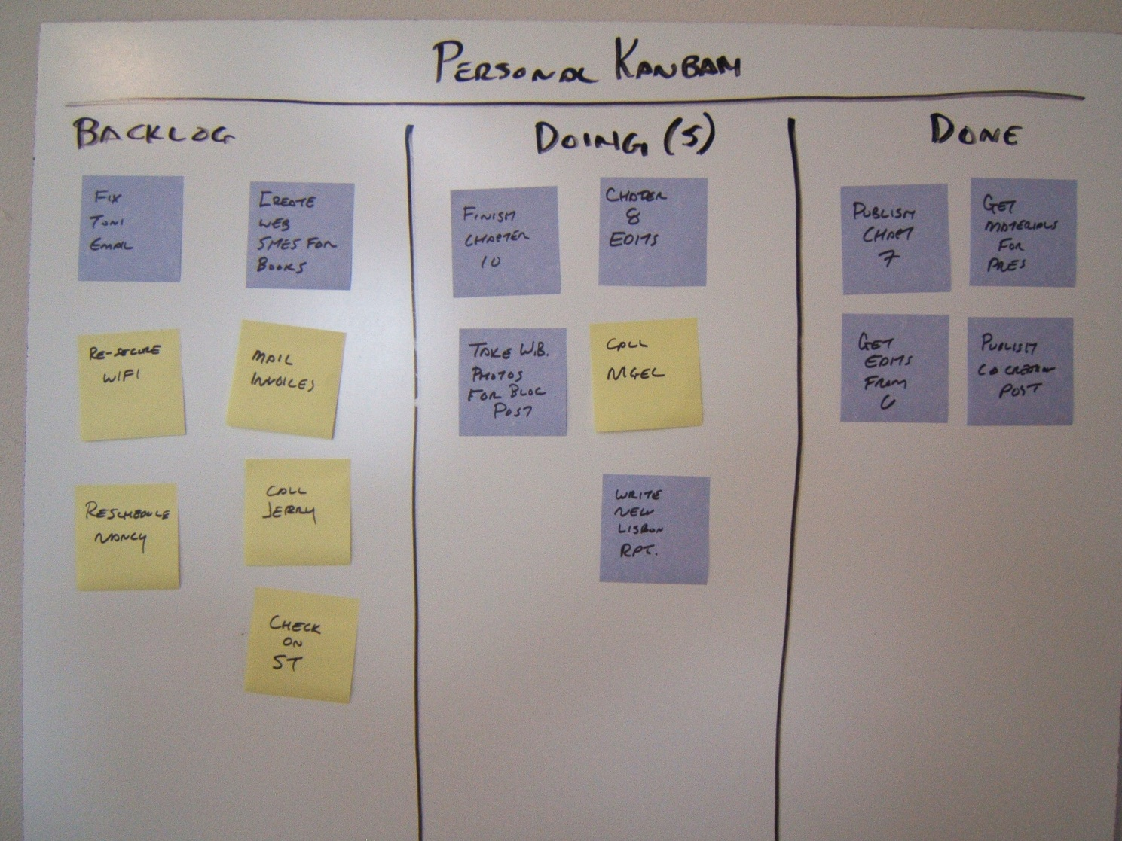
Whiteboards

Slide 32
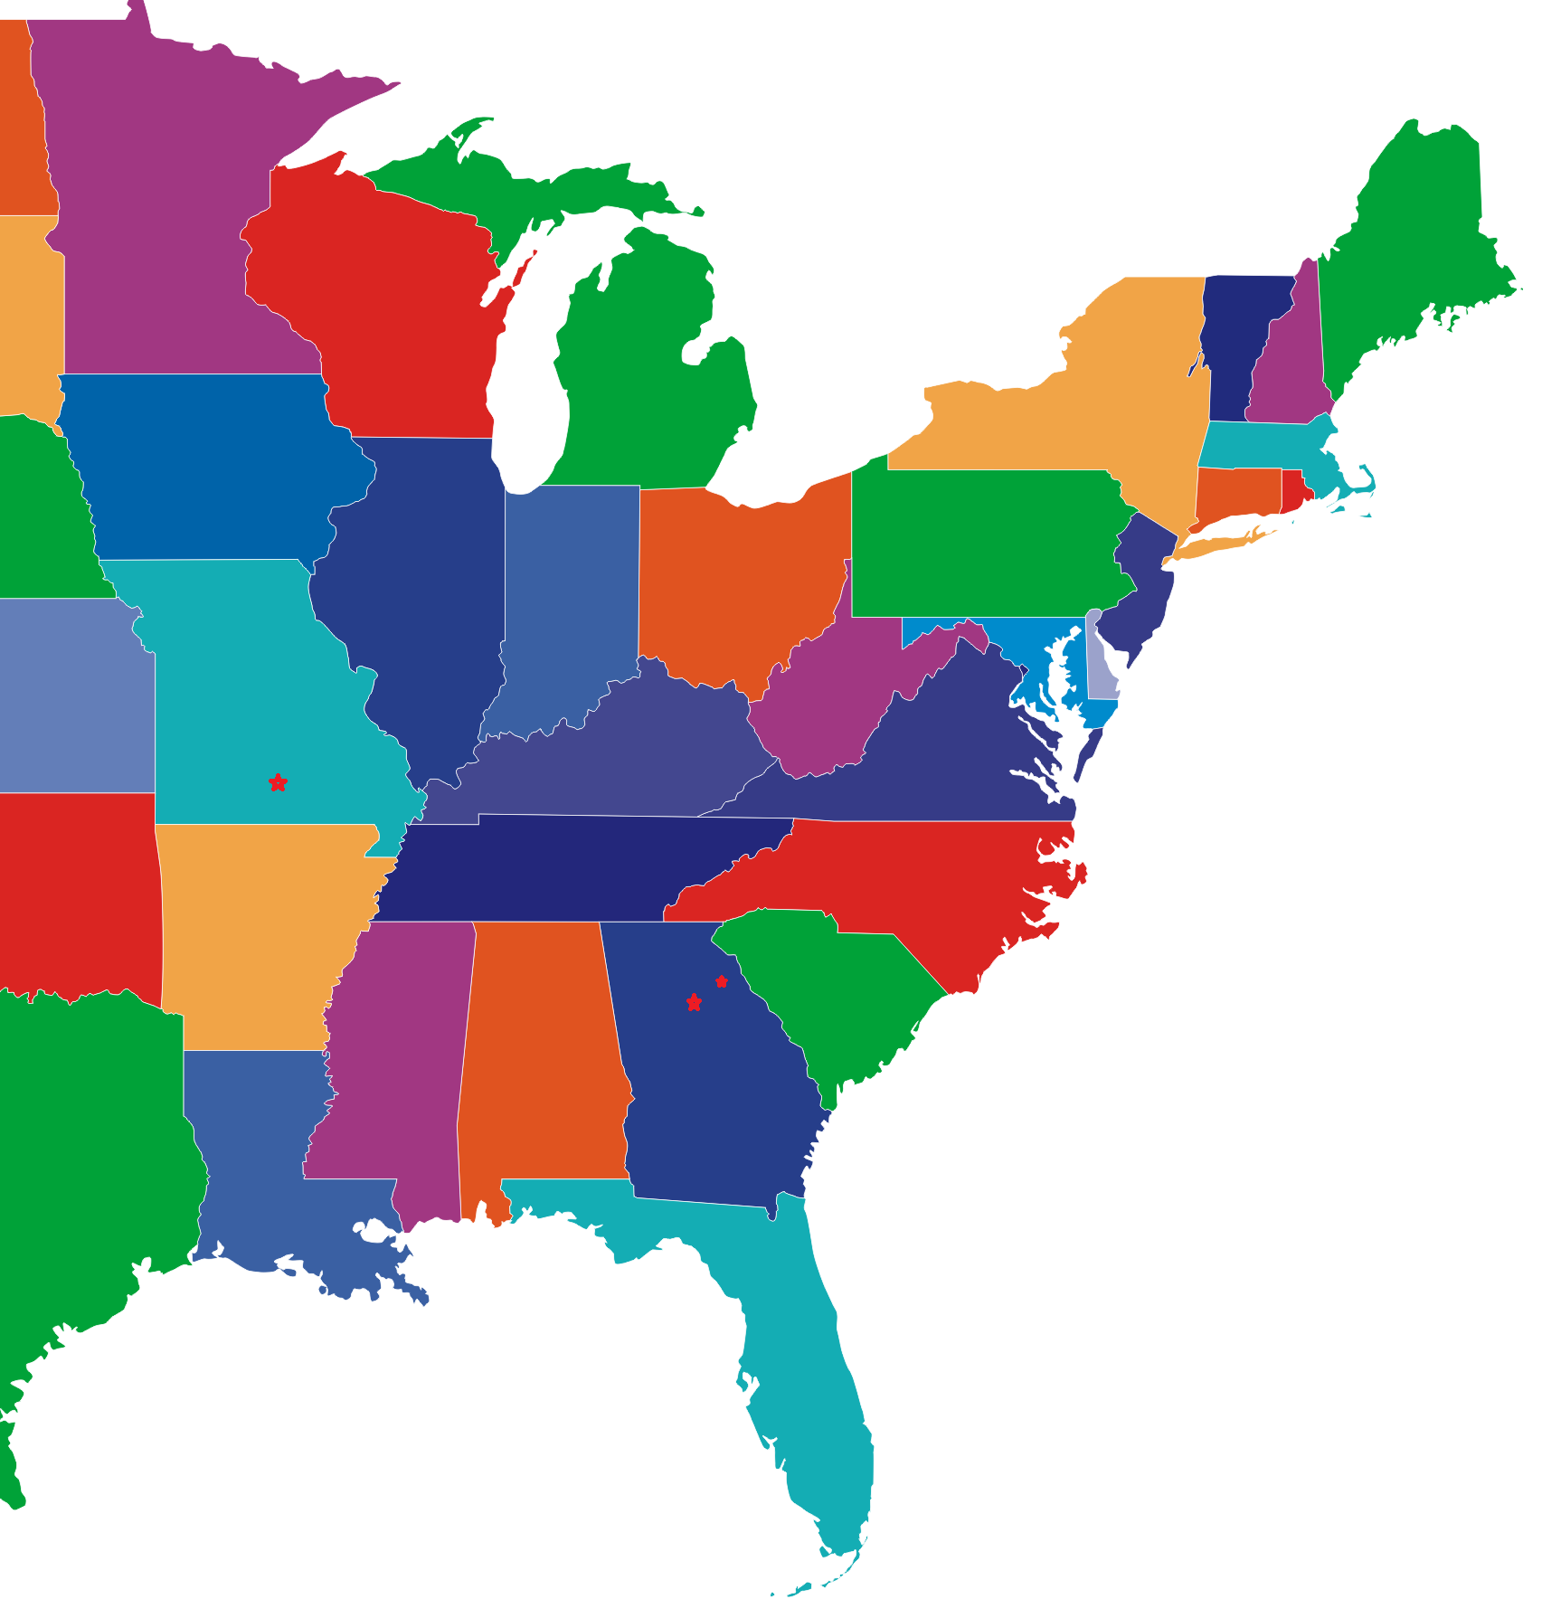

Slide 33
Electronic Kanban Boards
http://AgileZen.com
http://leankitkanban.com
Low-cost (free) project boards
We chose LeanKit
More users at free level
Better reporting
Swimlanes

Slide 34
LeanKit Kanban
DEMO

Slide 35
How My Team Does It
In the beginning….
Story Card (Work) – Each story represents 4 hours of work
Excludes daily repetitious tasks
Monitoring
Maintenance
Daily Standups to review cards
Product Owners invited

Slide 36
How My Team Does It
Phases – Actual steps of workflow
Doing – Things we’re actually working on.
To Do – Things we’ll do next.
Done – Tasks that are complete.
Backlog – Half-baked ideas/stories
Archive – Stuff that’s really done
Doing (Waiting) – Things we need to pause on
Handoff to Dev – Things we can’t fix; off to devs.

Slide 37
How My Team Does It
Swimlanes – we don’t use them (yet)
WIP –
To Do: 4 per team member
Doing (Active) 2 stories per member, -1 per team
Doing (Waiting) 1 per member
Standups allow shift of priority

Slide 38
How My Team Does It
Reporting
Cycle Time – how long it takes for a story to move from “To Do” to “Done”
Cumulative Flow – flow of work from phase to phase and growth over time

Slide 39
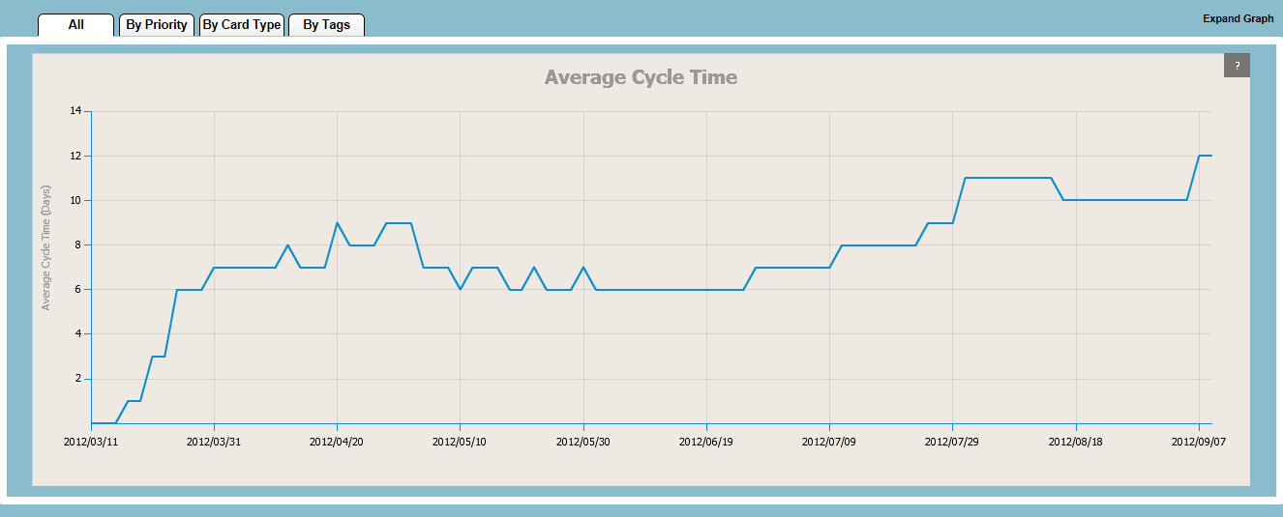
Cycle Time

Slide 40
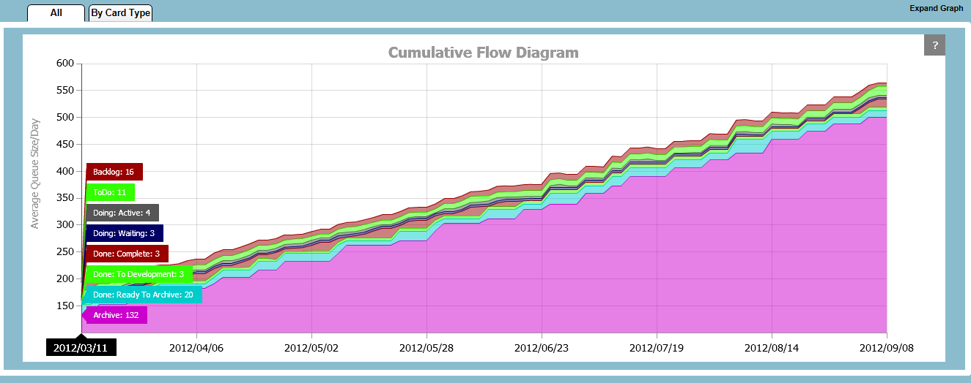
Cumulative Flow

Slide 41
How My Team Does it (Redux)
Things change…
Not enough depth in reporting
No vision into WHERE efforts were being spent
Great for tracking bugs, but not for insight into “heading off fires”

Slide 42
How My Team Does It (Redux)
Maintenance
Conceptual & Logical
Business needs to data infrastructure
Research & Development
Best Practices
Proofs of concept
Support
Why won’t this….?
Configuration changes
Traditional DBA work
Monitoring; performance tuning
Architecture

Slide 43
How My Team Does It (Redux)
Cards are now typed by categories
Card base unit is 1 hour
Card size increments in hours
WIP in lanes based on card, not size
Backlog is no longer used
Added new reports
Card distribution (percentage)
Reports now demonstrate overages

Slide 44
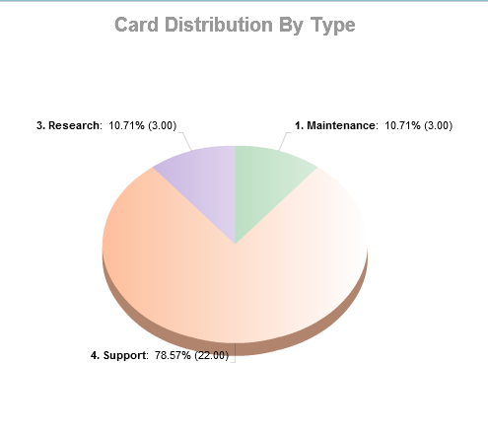
Card Distribution

Slide 45
Scrum vs Kanban
Scrum and Kanban
Scrum
kanban
Cyclical
Time-Boxed
Change is expected
Fundamental shift in processes
Open-ended
Work-boxed
Change is irrelevant
Can be used in conjunction with existing processes

Slide 46
Resources
http://www.infoq.com/minibooks/kanban-scrum-minibook
http://www.slideshare.net/aaronbjork/scrum-with-tfs-2010
stuart@codegumbo.com
http://www.codegumbo.com
@codegumbo

